Slide 1
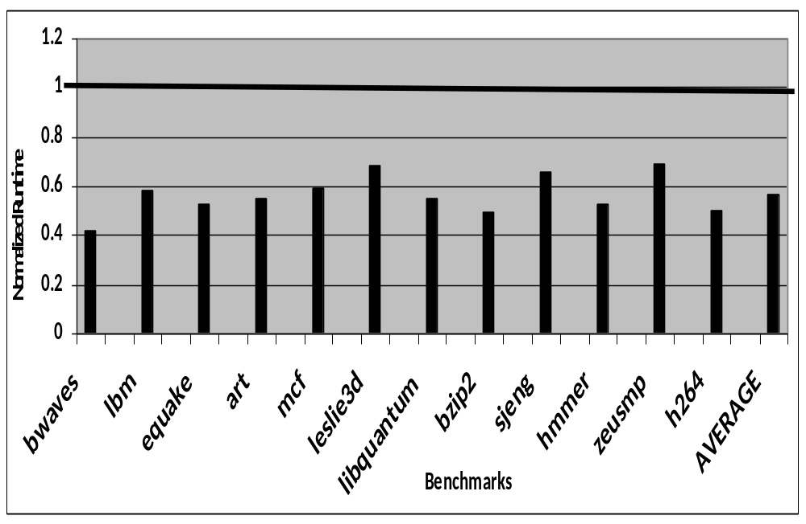

Slide 2
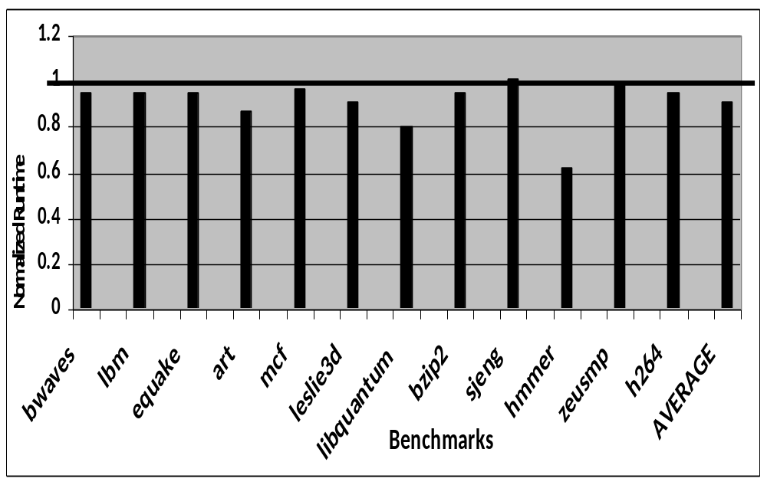

Slide 3


Slide 4
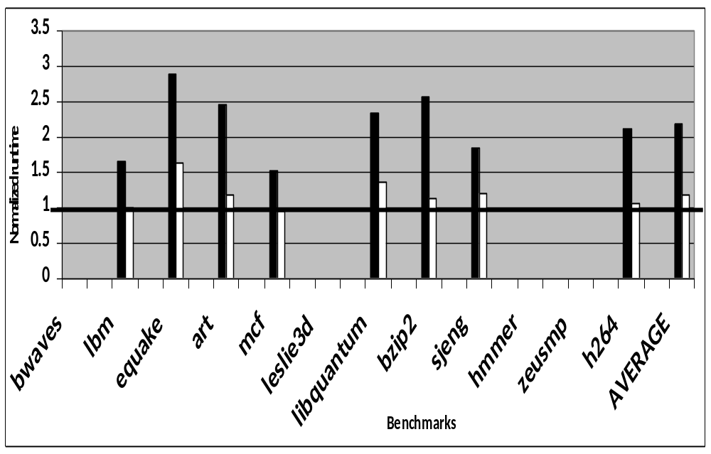

Slide 5
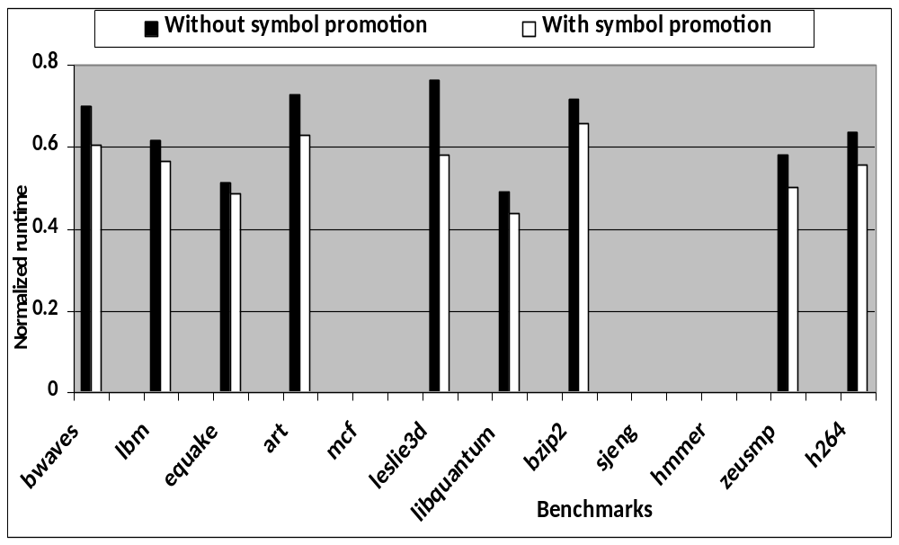

Slide 6
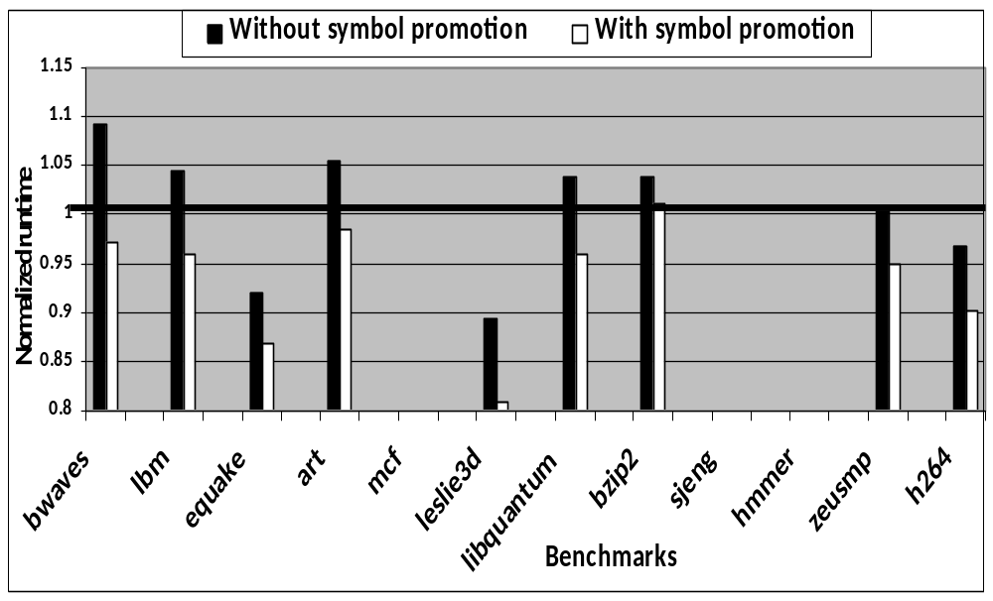

Slide 7
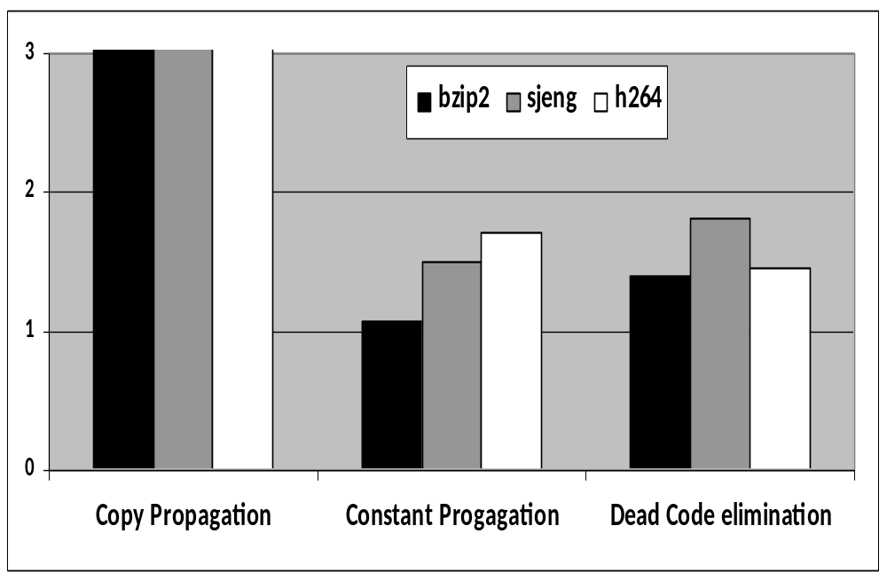

Slide 8
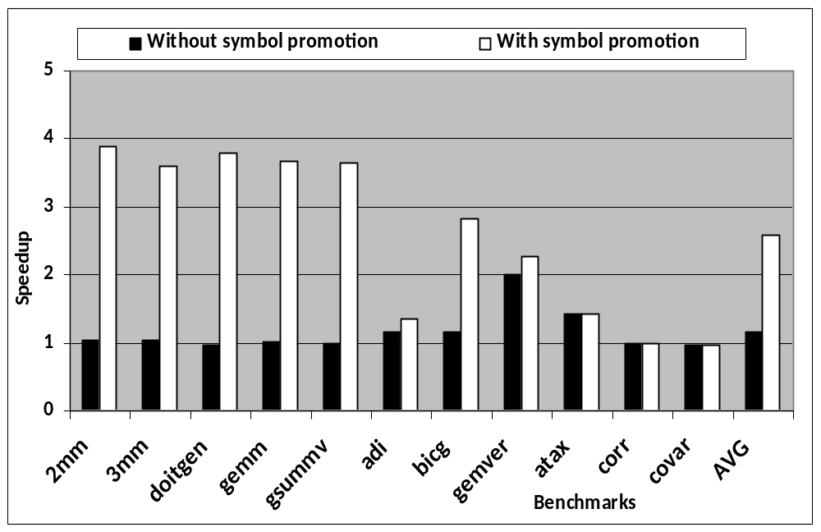

Slide 9
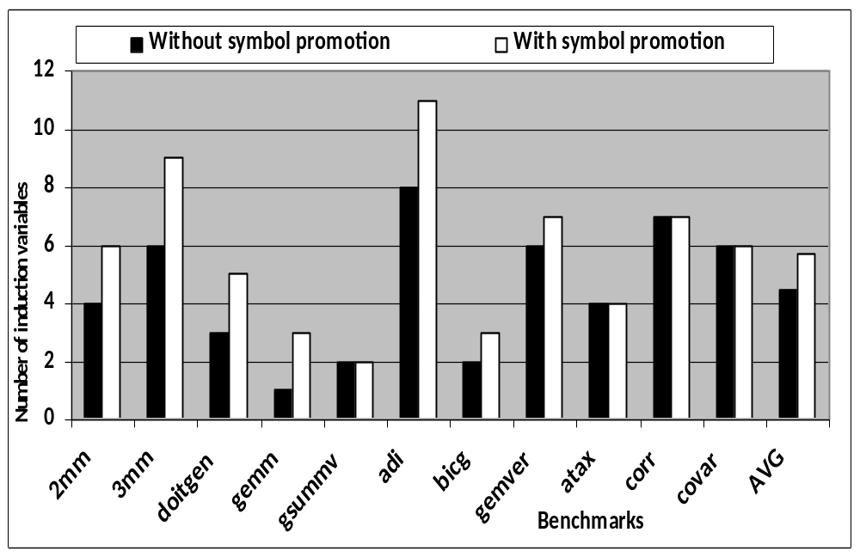

Slide 10
EXISTING LLVM COMPILER
C
LLVM front end
LLVM IR
Optimized
x86 back-end
Output binary
C++
LLVM IR optimizations
Ada
LLVM IR
Fortran
C back-end
Output C code
. . .
OUR NEW CODE
Input binary
Binary reader & disassembler
High IR enhancements
(Stack splitting,
Symbol conversion)
Optimizations
(Parallelization, Security)
LLVM IR
x86 ISA XML

Slide 11
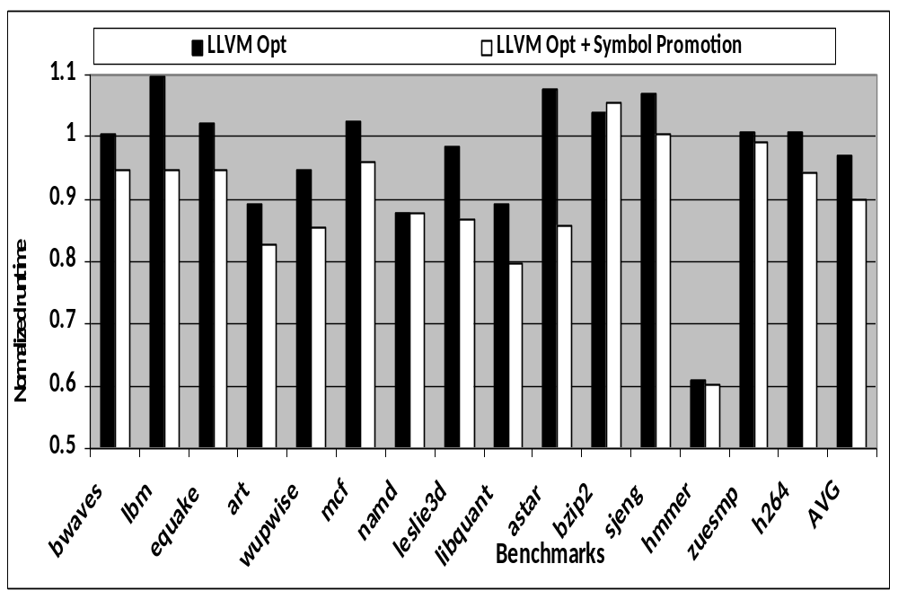

Slide 12
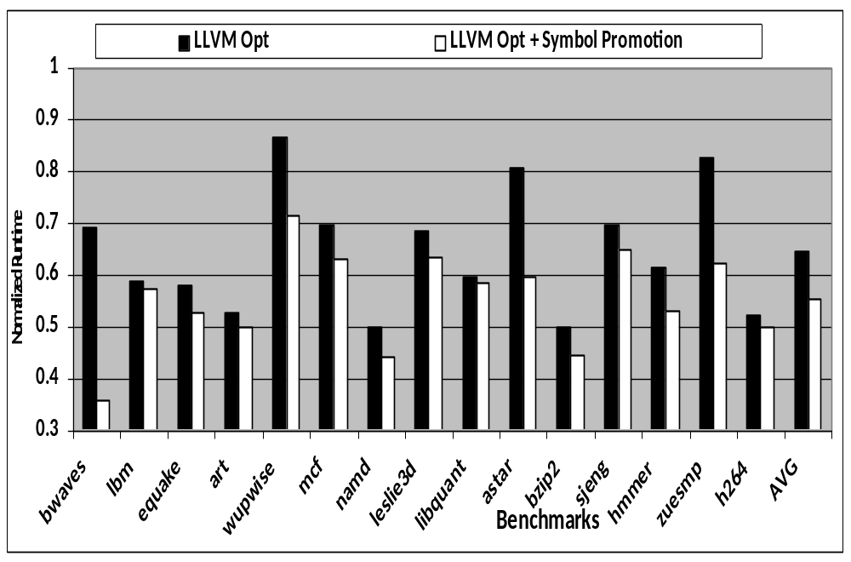

Slide 13
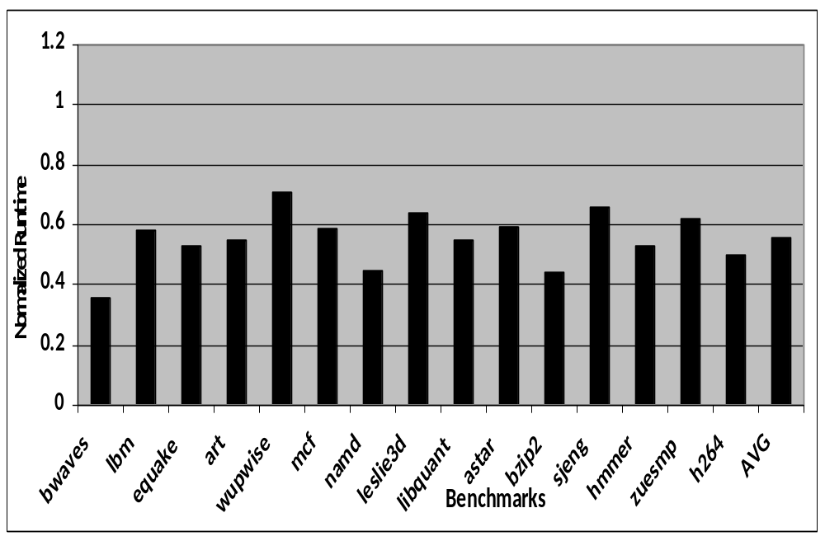

Slide 14
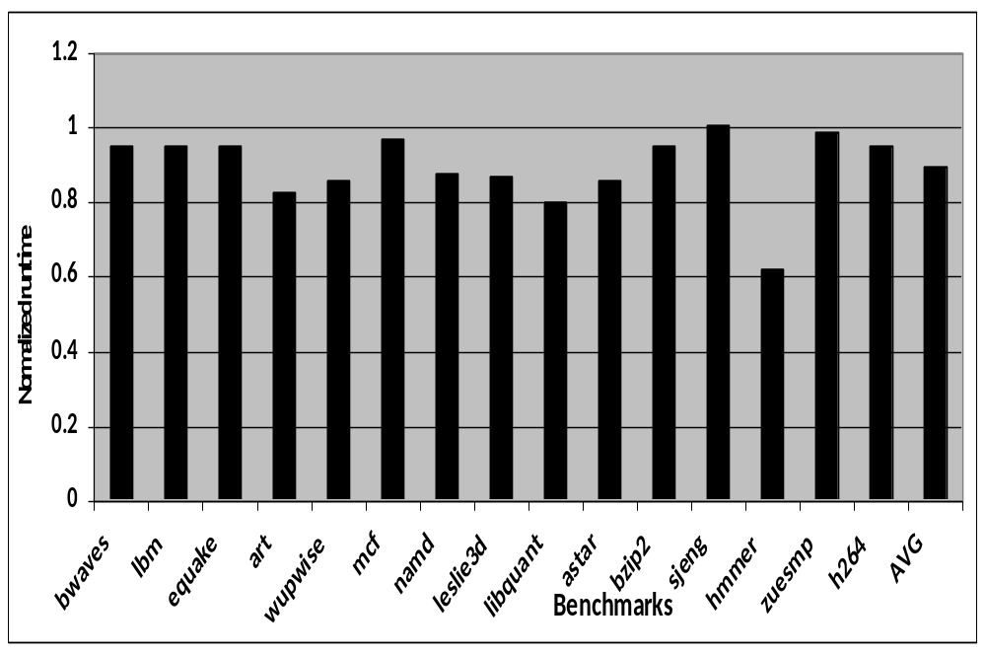

Slide 15
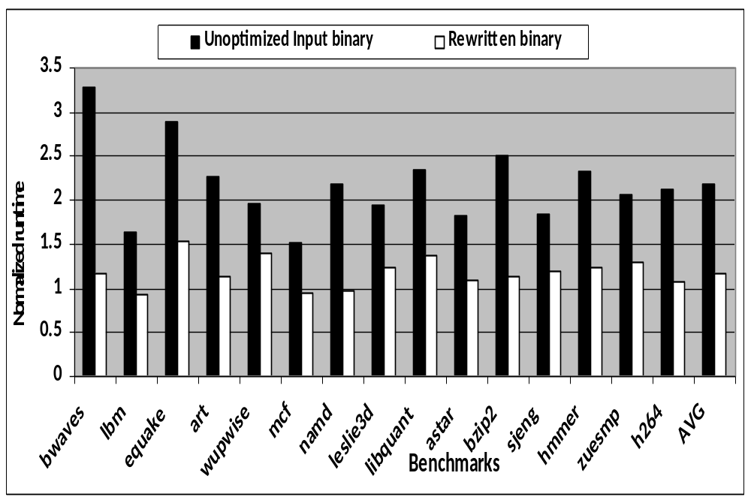

Slide 16
Incoming Arguments
Return Address
Entry Point
Local Variables/
Callee Arguments

Slide 17
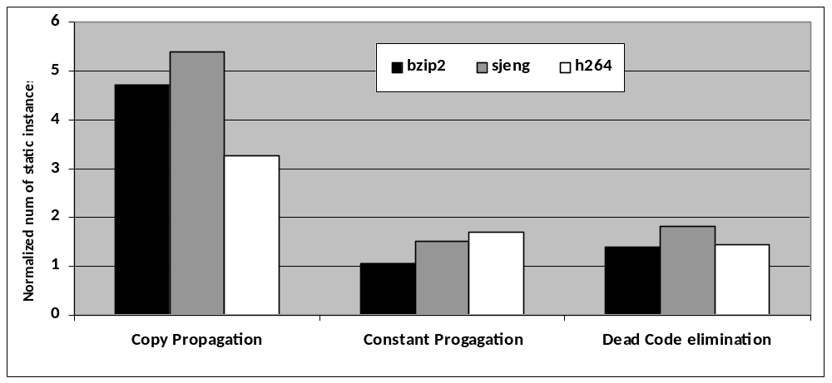
x10

Slide 18
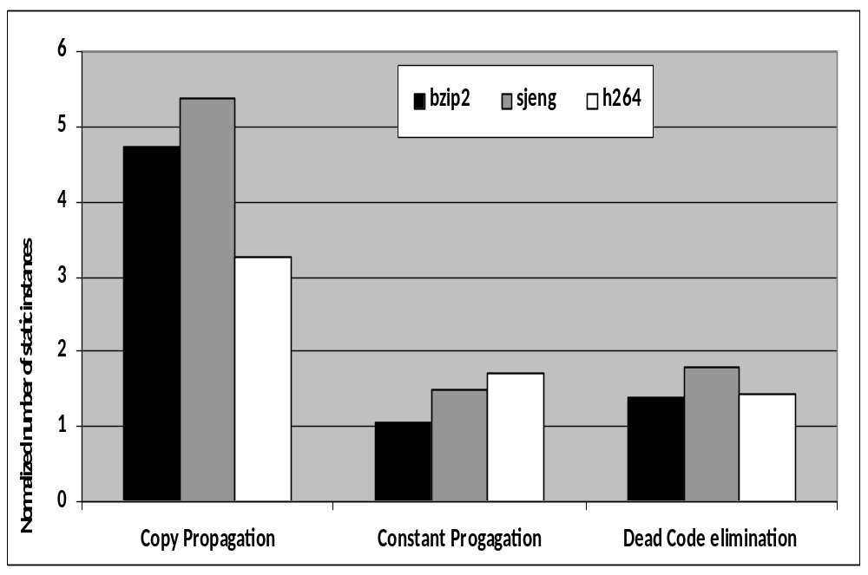
10x

Slide 19
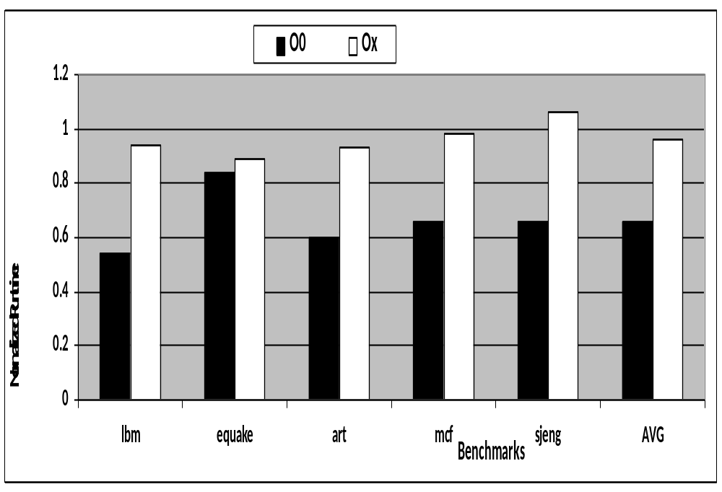

Slide 20
